Slide 1
Sound and video editing
Lesson 1: Introduction to sound editing and Audacity

Slide 2
Objectives
In this lesson, you will learn how to:
import tracks into a digital audio workstation
plan a radio advert
record using a microphone.

Slide 3
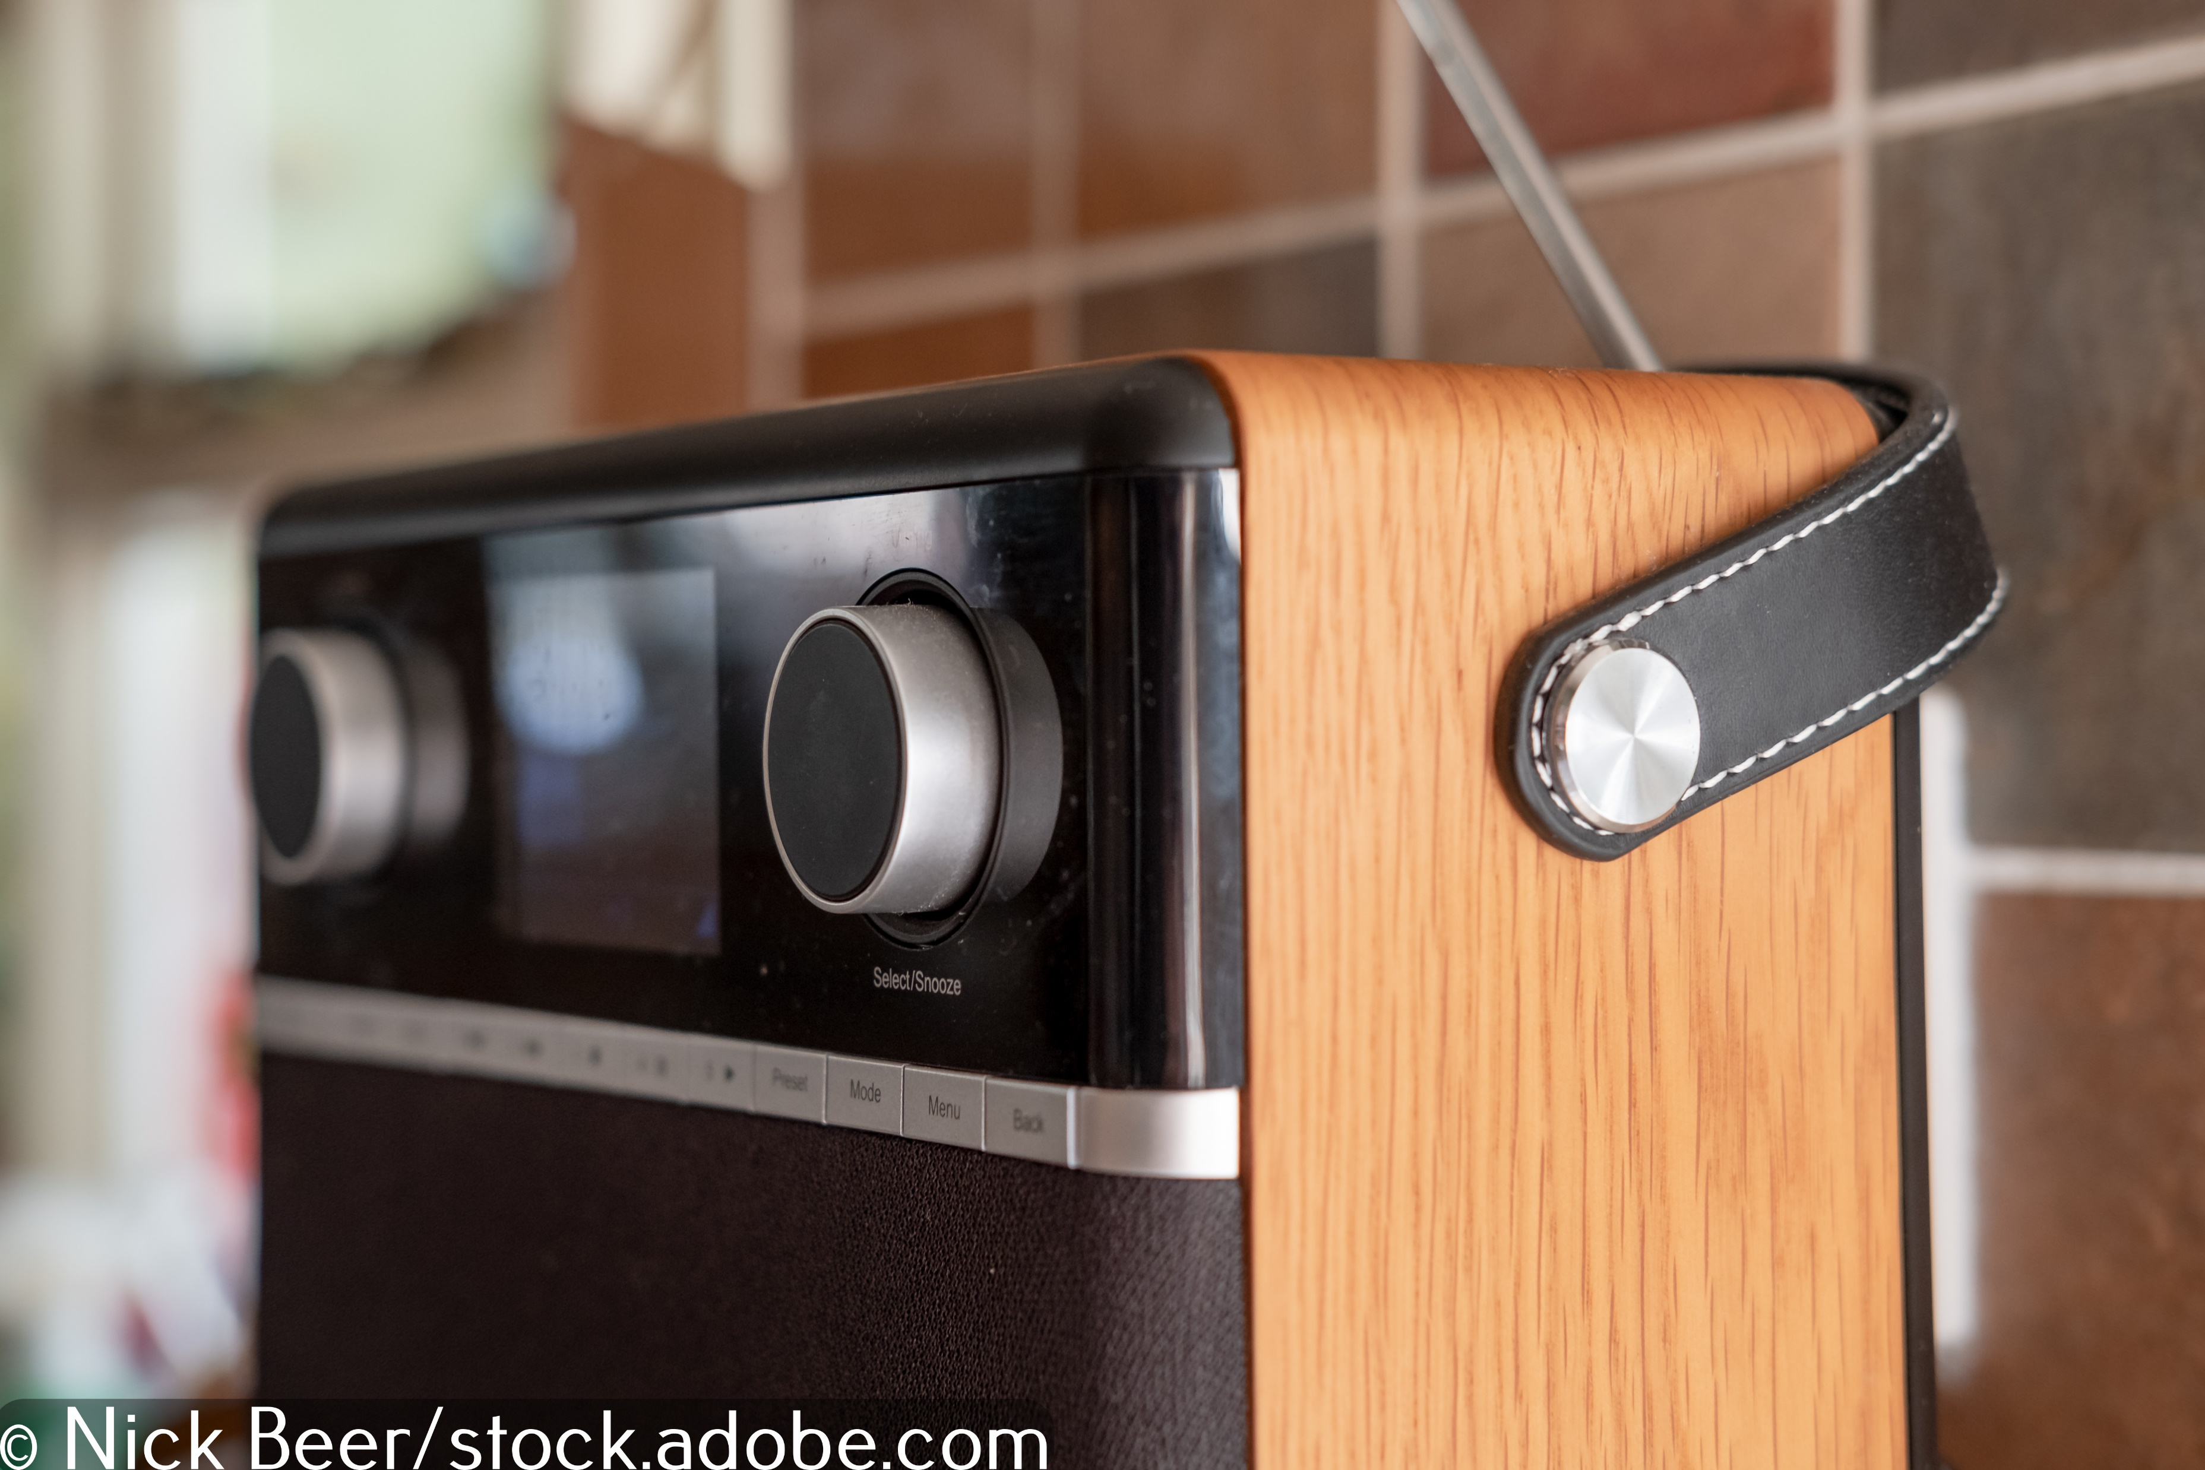
Radio advert
Listen to the radio advert and try to identify as many separate sounds as possible.
Listen to Audio 1.1

Slide 4

Sound editing software
You are going to be learning how to record and edit sound using a DAW (Digital Audio Workstation).
As it is free and powerful, you will be learning how to use Audacity, but other DAWs work in a similar way.

Slide 5
Sound editing software
One audio track is made up of lots of smaller audio tracks; more than one sound is played back to create one audio file. This is why audio is often referred to as multi-track.
To ensure all the sounds come together to form something you want to listen to, sound designers work from a timeline.
On the next slide is an example of an audio timeline. Listen to the radio advert again. Can you see how the audio blocks on the timeline relate to the sounds in the advert?

Slide 6
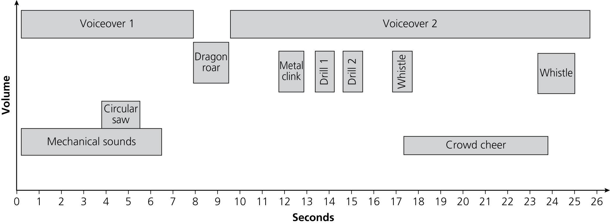
Sound editing software
Notice how the audio timeline moves chronologically from left to right.
Notice how the audio timeline shows louder sounds at the top and quieter sounds at the bottom.
Notice how specific sounds are played at specific times.
Listen to
Audio 1.1

Slide 7
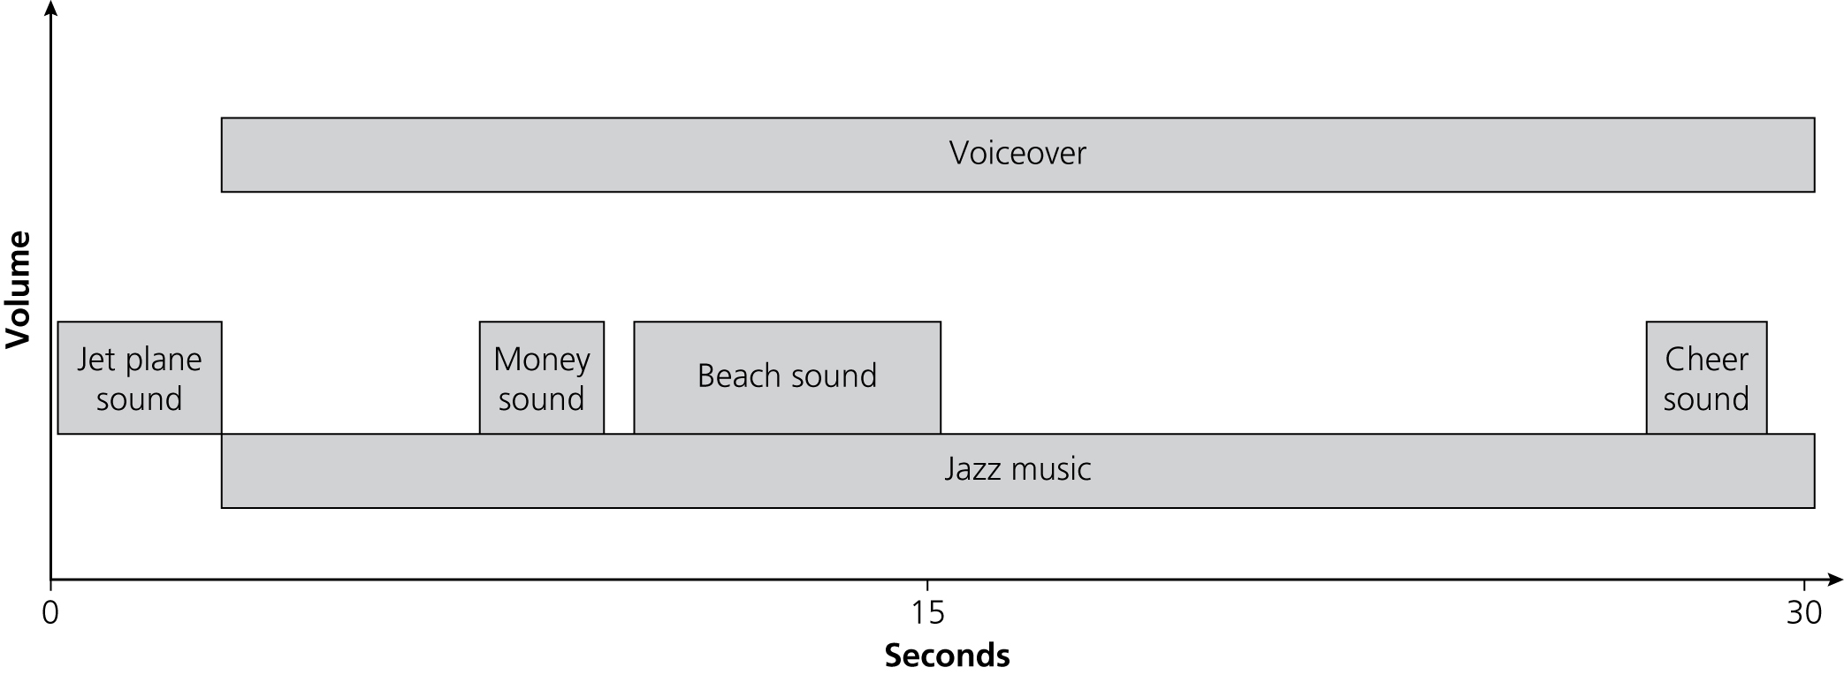
Recording a radio advert
Over the next two lessons, you will be creating a radio advert based on this timeline:
In this lesson, you will focus on gathering and recording sounds and moving them into the correct position in Audacity.
By the end of the lesson, your advert should sound something like Audio 1.2.
Don’t worry if it doesn’t sound completely professional yet! You will be adding effects next lesson.

Slide 8

Importing audio tracks
When you open Audacity, you are presented with a blank template.
Click on ‘File’, ‘Import’ and ‘Audio’ to import sounds into Audacity.
Then click on ‘View’, ‘Track size’ and ‘Fit to Height’ to resize the sounds so you can see them all on your screen at the same time.
Now watch Video 1.1

Slide 9

Activity 1.1: Importing audio tracks
Import Sounds 1.1 into Audacity.

Slide 10

Arranging the composition
Now that you have imported your audio tracks, you can start to arrange them according to the audio timeline.
To do this, use the ‘Time Shift Tool’ to move the audio files around.
Top tip: Press and hold ‘ctrl’ (or ‘cmd’ if you are using a Mac) on your keyboard and use the mouse wheel to expand or contract the tracks.

Slide 11

Trimming tracks
If you want to trim one of the audio tracks, you can use the ‘Selection Tool’ to select the audio you want to delete and then press the ‘Delete’ key on your keyboard.
Watch Video 1.2
To play your soundtrack at any time, press the space bar or click on the ‘Play’ button. To stop playback, press the space bar again or click on the ‘Stop’ button.

Slide 12
Activity 1.2: Arranging the composition and trimming
Arrange the audio tracks you imported according to the audio timeline and trim them if necessary.

Slide 13
Recording the voiceover
Now that your audio tracks are roughly in the right place, you need to use the script to record a voiceover.
To record a voiceover, click on ‘Tracks’, ‘Add New’ and ‘Stereo Track’.
Make sure your microphone is positioned properly and click the ‘Record’ button. When you have finished click the ‘Stop’ button.
Press the space bar to play the whole soundtrack, or mute the other tracks by clicking on the ‘Mute’ tabs, and press the space bar to play only the voiceover.
Use the ‘Selection Tool’ to trim your voiceover track and the ‘Time Shift Tool’ to move it into the right place.
Watch Video 1.3

Slide 14
Activity 1.3: Recording the voiceover
Record your voiceover using the script provided, or import Sounds 1.2.

Slide 15

Adjusting the levels
You may have noticed that, when you press ‘Play’, all the audio tracks are at the same volume.
You can adjust the volume – or level – of each track using the fader on each of the tracks.
Watch Video 1.4

Slide 16
Activity 1.4: Adjusting the levels
Change the volume of each track, so that levels match the audio timeline.
It is important to ensure the voiceover is clear and easy to hear because the voiceover is the most important part of the advert.

Slide 17
Quiz 1

